Slide 1
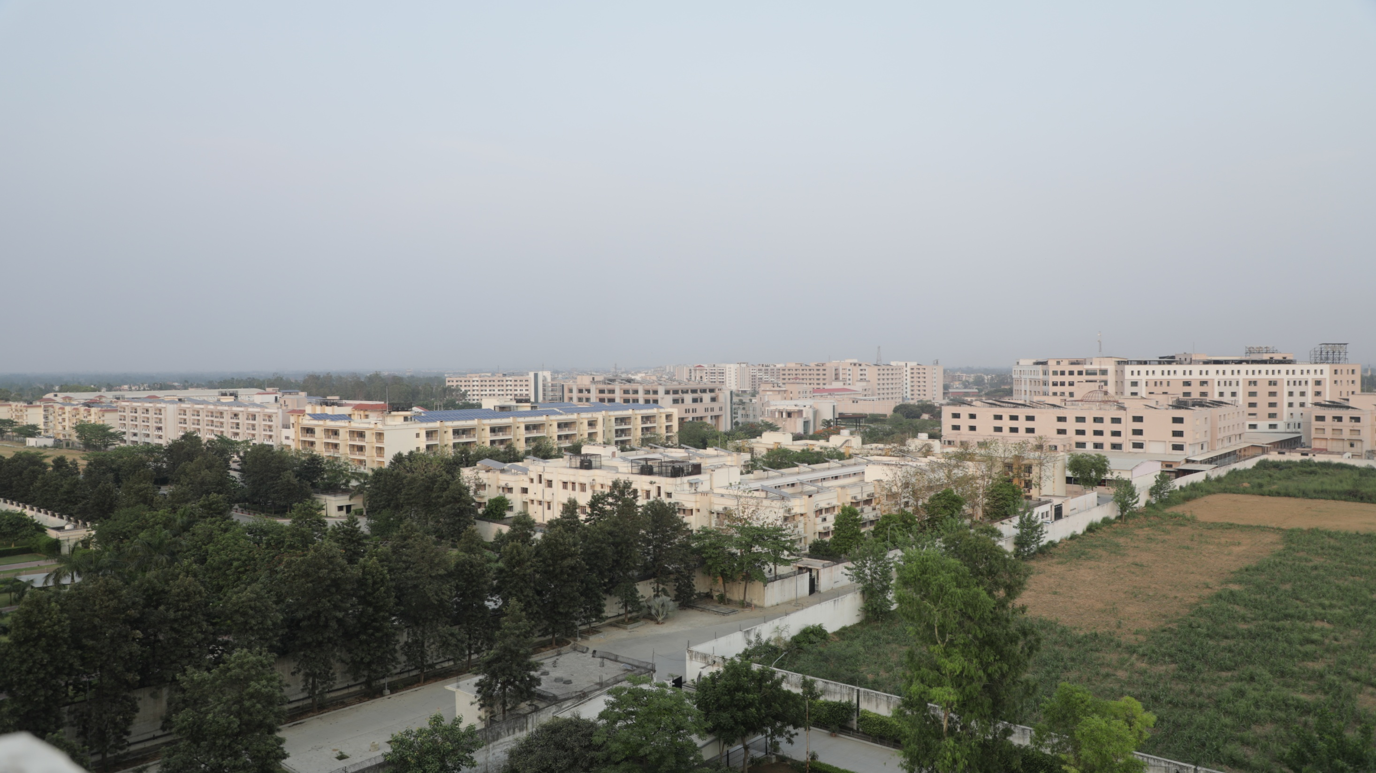

Teerthanker Mahaveer University
Welcomes
Esteemed members of NBA Expert Committee for the Visit Department of Computer Science & Engineering
March 25-27, 2022

Slide 2

CONTENTS:
B. ACADEMICS
Faculty & Staff
Admission Process
Academic Approach
Examination Process
Student Details, Support & Progression
Research, Innovation & Projects
Collaborations & MoUs
Extension & Outreach Activities
Sports , Convocations & Cultural Activities
C. Infrastructural & Other Facilities
D. Awards & Achievements
E. Best Practices
F. Aligning to Future
G. University in News
A. ABOUT THE UNIVERSITY:
Background
Vision , Mission &Values
A Snapshot
Colleges/Departments of Study
Statutory approvals
Governance
Organogram
Chancellor’s profile

Slide 3
A. ABOUT THE UNIVERSITY
Background
Vision , Mission &Values
A Snapshot
Colleges/Departments of Study
Statutory approvals
Governance
Organogram
Chancellor’s profile

Slide 4
a. Background
Established in 2001 as Teerthanker Mahaveer Institute of Management & Technology (TMIMT) : the seed grew into a big Banyan tree in the form of Teerthanker Mahaveer University.
A Jain Minority Private University established by an 'Act' (No. 30) of 2008 of the Government of Uttar Pradesh & Incorporated under U.P. Private Universities Act 2019
Approved by the University Grants Commission (UGC), since inception in 2008, vide letter No. F. 9-31/2008(CPP-1) dated October, 27,2008 and recognized under section 12 B of UGC Act 1956.
Accredited by NAAC in 2016.

Slide 5
b. Vision , Mission & Values
-: Vision :-
To be recognized as a premier institution of excellence providing high quality education, research and consultancy services to the society.
-: Mission :-
Our endeavor is to impart knowledge and develop critical skills necessary to succeed both in professional and personal life by promoting learning supported by world-class faculty, infrastructure, technology, curricula and collaborative teaching and research with premier institutions in India and abroad.
-: Values :-
Adherence to Lord Mahavira’s Guiding Principles: Right Knowledge, Right Philosophy, Right Conduct

Slide 6
1. A Multi-Disciplinary University
2. Offering career & skill oriented programmes at all levels i.e. Diploma UG, PG and Doctoral degrees.
3. 13 Diverse streams,
4. 20+ years of excellence
5. 800+ experienced academicians
6. 10000+ Students
7. 145+ acres of campus
8. 1008+ bed super specialty Hospital
9. High capacity oxygen generator unit manufactured & funded by the French company
10. State of the Infrastructural & other exclusive facilities
11. Well Equipped laboratories and research facilities.
12. Well planned residential space for faculty & staff
13. Hostels for boys & girls with canteen facilities
14. Well Developed ecosystem for co-curricular, extra curricular activities.
15. World class sports facilities & State-of-the-art Gymnasium
16. Fully wi-fi enabled campus
17. Family restaurant of Bikano & Temptation with a wide range of exclusive eateries.
18. Microsoft ERP with fully automated and computerised functioning of University’s key processes
c. TEERTHANKER MAHAVEER UNIVERSITY: A SNAPSHOT

Slide 7
d. Colleges /Departments: 13
Medical college & Research Centre
Dental College & Research Centre
College of Nursing
College of Pharmacy
College of Paramedical Sciences
College of Computing Sciences &Information Technology
Faculty of Education & Physical Education
Department of Physiotherapy
Faculty of Engineering
& CCSIT
TMIMT College of Management
College of Agriculture Sciences
College of Law & Legal Studies
College of Fine Arts

Slide 8
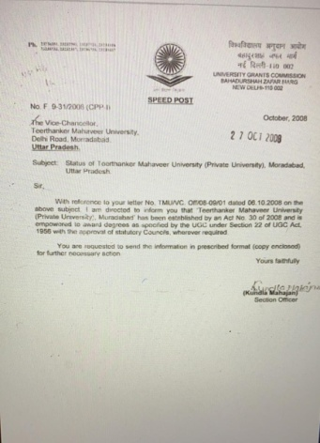
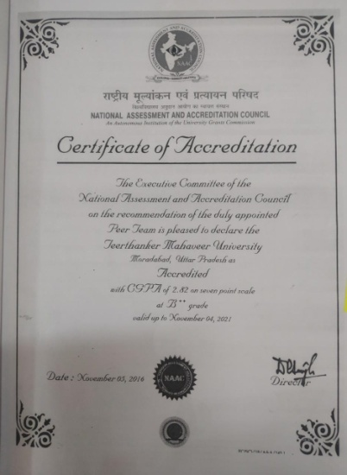
e. Statutory Approvals
UGC RECOGNITION
Approved by University Grants Commission (UGC) under Section
2(f) & 12 (B) and has powers to award degrees u/s 22(1) of UGC Act, 1956
NAAC ACCREDITATION.

Slide 9
Contd….
Council Approved Programmes | Approved by
M.B.B.S., M.D., M.S. | National Medical Council (NMC)
B.D.S., M.D.S. | Dental Council of India (DCI)
B.Sc.(RIT)(MLT)(Optometry) BPT, M.Sc. (RIT)(MLT)(Optometry), MPT | U.P. State Medical Faculty (UPSMF)
M.Sc., B.Sc., Post Basic B.Sc. Nursing | Indian Nursing Council (INC)
D.Pharm, B.Pharm, Pharm.D., M.Pharm (Pharmaceutics and Pharmacology | Pharmacy Council of India (PCI)
BA-LLB (Hons.) BBA-LLB (Hons) B.Com-LLB (Hons) | Bar Council of India (BCI)
B.PEd., M.PEd., B.Ed, M.Ed., Integrated B.Ed. | National Council of Teacher Education(NCTE)
B.Tech (CSE) B.Tech (ME) B.Tech (EE) B.Tech (ECE) | All India Council for Technical Education (AICTE)

Slide 10
f. GOVERNANCE : Statutory Bodies
    GOVERNING BODY
    EXECUTIVE COUNCIL
    ACADEMIC COUNCIL
    BOARD OF FACULTY
    BOARD OF STUDIES
    FINANCE COMMITTEE
    PLANNING BOARD

Slide 11
OTHER INSTITUTIONAL COMMITTEES
Examination Committee
Admission Committee
Grievance Redressal Committee
Internal Complaints Committee
Proctorial Board
Library Committee
Hostel Committee

Slide 12
GOVERNING BODY
Name | Designation | Organization & Address | Status
Shri Suresh Jain | Chancellor | Teerthanker Mahaveer University, Delhi Road, Moradabad | Chairman
Shri Manish Jain | Group Vice Chairman | Teerthanker Mahaveer Institute of Management& Technology, Moradabad | Member
Prof. Raghuvir Singh | Vice Chancellor | Teerthanker Mahaveer University, Delhi Road, Moradabad | Member
Smt. Rinku Mittal | Member | Nominee of the Sponsoring Body | Member
Ms. Arunima Mittal | Member | Nominee of the Sponsoring Body | Member
Shri Akshat Jain | Member | Nominee of the Sponsoring Body | Member
Shri Vipin Jain | Member | Nominee of the Sponsoring Body | Member
Shri Ashu Jain | Member | Nominee of the Sponsoring Body | Member
Ms. Swati Jain | Member | Nominee of the Sponsoring Body | Member
Shri D. K. Jain | Legal Expert | Practicing Advocate | Member
Prof. R. K. Mittal | Vice Chancellor | Chaudhary Bansi Lal University, Hansi Road, Bhiwani (Haryana) | Member
Shri Sandeep Vaish | Financial Expert | Chartered Accountant, Moradabad | Member
Shri B. N. Vij | Industrialist | Asian Handicrafts, Moradabad | Member
Dr. Aditya Kr. Sharma | Registrar | Teerthanker Mahaveer University, Delhi Road, Moradabad | Member Secretary

Slide 13
EXECUTIVE COUNCIL
Sl. No. | Name | Designation | Organization & Address | Status
1 | Prof. Raghuvir Singh | Vice Chancellor | Teerthanker Mahaveer University, Delhi Road, Moradabad | Chairperson
2 | Shri Akshat Jain | Member, Governing Body | Teerthanker Mahaveer University, Delhi Road, Moradabad | Member
3 | Ms. Arunima Mittal | Member, Governing Body | Teerthanker Mahaveer University, Delhi Road, Moradabad | Member
4 | Prof. K. K. Pande | Dean (Academics) | Teerthanker Mahaveer University, Delhi Road, Moradabad | Member
5 | Prof. R. M. Dubey | Former Vice Chancellor | IFTM University, Delhi Road, Moradabad | Member
6 | Prof. Kuldeep Singh Bansal | Chairman, Department of Mathematics | Guru Jambheshwar University of Science & Technology, Hisar, Haryana | Member
7 | Prof. Jai Pal Vyast | MLC | U. P. State Legislative Council, Moradabad, Uttar Pradesh | Member
8 | Shri Vishal Sehgal | Director | Nischay Educorp Private Limited, New Delhi | Special Invitee
9 | Prof. Rakesh K. Dwivedi | Principal | College of Computing Sciences & IT, Teerthanker Mahaveer University, Delhi Road, Moradabad | Member
10 | Dr. Ankita Jain | Associate Professor | Dental College & Research Centre, Teerthanker Mahaveer University, Delhi Road, Moradabad | Member
11 | Dr. Harshit Jain | Finance Officer | Teerthanker Mahaveer University, Delhi Road, Moradabad | Ex-Officio
12 | Dr. Aditya Kr. Sharma | Registrar | Teerthanker Mahaveer University, Delhi Road, Moradabad | Member Secretary

Slide 14
ACADEMIC COUNCIL: COMPOSITION
The Vice-Chancellor Ex-Officio Chairman
All Deans Ex-Officio
All Directors Ex-Officio
All Heads of Departments Ex-Officio
One Professor from every department
Two Associate Professors and two Assistant Professors (Members by rotation in order of seniority).
Two distinguished academicians from outside the University to be nominated as members by the Chancellor :
i) Dr. S. K. Sharma, Department of Internal Medicine, All India Institute of Medical Sciences, New Delhi
ii) Prof. A. R. Tripathi, Faculty of Commerce & Management Studies, Banaras Hindu University, Varanasi
9. The Registrar – Secretary (Ex-Officio)

Slide 15
g. ORGANOGRAM
1. Governance
Secretariat
Chancellor
Planning Board
Governing Council
Academic Council
Vice Chancellor
Finance Committee
Executive Councils
Secretariat
Pro Vice Chancellor
Registrar
Jt. Registrar (R&D)
Jt. Registrar (HR)
Jt. Registrar (Academic)
Jt. Registrar (Admin)
Assistant Registrar (R&D)
Assistant Registrar (HR)
Assistant Registrar (Academic)
Assistant Registrar (Admin)
2. Academic
3. Administrative
4. Academic & Administrative Facilitation
Dean Academic
Associate Dean Academic
Director (Administration)
Director (Admission)
Director (Corp. Affairs)
Director (Hospital Admi.)
Director (Student Welfare)
Finance Officer
COE
Director CTLD
Librarian
IQAC
Coordinator
JCE
IT Cell Head
Hostel Warden
Civil Engineering
Public Relation Manager
Transport Head
ERP Head
Digital Marketing Manager
Dy. Director (Admission)
Dy. Librarian
Faculty Board
Director ( International Affairs)
Dy. Director (Account)
Principal Medical
Principal Dental
Principal CCSIT
Principal Polytechnic
Principal Nursing
Principal Pharmacy
Principal Engineering
Principal TMIMT
Principal Education & Physical Education
Principal Paramedical
Principal Agriculture
Principal Physiotherapy
Principal Fine Arts
Chief Proctor
Dy. Director (Security)
Board of Studies
Director(Hospi. Planning & Dev)
ARC
HOD

Slide 16
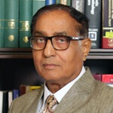
h. ABOUT THE CHANCELLOR
Hon’ble Shri Suresh Jain
A true philanthropist, multi-faceted educationist and industrialist.
Since the last 50 years, Shri Suresh Jain has been a prominent figure in the pan-India Jain community.
A chartered member of the Rotary Club since 1974 and played an instrumental role in the eradication of poliovirus in Uttar Pradesh.
Established the Teerthanker Mahaveer Hospital in 2008 to render best-in-class medical services to the community at a very reasonable cost.
Was felicitated with the Bhagwan Rishabhadeva International Award in 2018 by the then Chief Minister of Maharashtra Shri Devendra Fadnavis in the gracious presence of Hon’ble President of India Shri Ram Nath Kovind.
A champion of ecology and biodiversity- has planted more than 60000 trees in his village school near Moradabad to protect and conserve the land.

Slide 17
a. Faculty & Staff
Total No. of Teaching Staff : 816
Total No. of Non -Teaching Staff : 802
S. No. | Cadre | Sanctioned Number | Appointed
1. | Professor | 105 | 141
2. | Associate Professor | 157 | 146
3. | Assistant Professor | 492 | 529
 | Total | 754 | 816

Slide 18
Sl. No. | Description Nos. (As on 26.02.2022)
A) | PhDs 158
B) | NET/SLET 232

Slide 19
b. ADMISSION PROCESS:
As per UP Private University Act 2019, in accordance with the Academic Ordinance of the University and guidelines issued from UGC, NMC, DCI, AICTE, PCI, BCI, NCTE and other statutory bodies from time to time.
For programmes like MBBS, BDS, MD, MS and MDS, the admission is
done through NEET.
For programmes like Ph. D. (TRAT), Nursing, Pharmacy and Para-medical Sciences, it is done through University Entrance test.
For all other programmes of the University, the admission is done on the
basis of merit of the qualifying exam.

Slide 20
Education Philosophy (Purpose)
Education Philosophy :
Education Purpose
Knowledge Dissemination(Teaching)
Knowledge creation (Research)
Employability & entrepreneurship (Industry Focus )
E & E
(Kd)
(Kc)
(E &E)
KD
(KC)
Low
20
30
40
50
80
90
100
High
0
12
60
70
Time, Effort & Investment

Slide 21
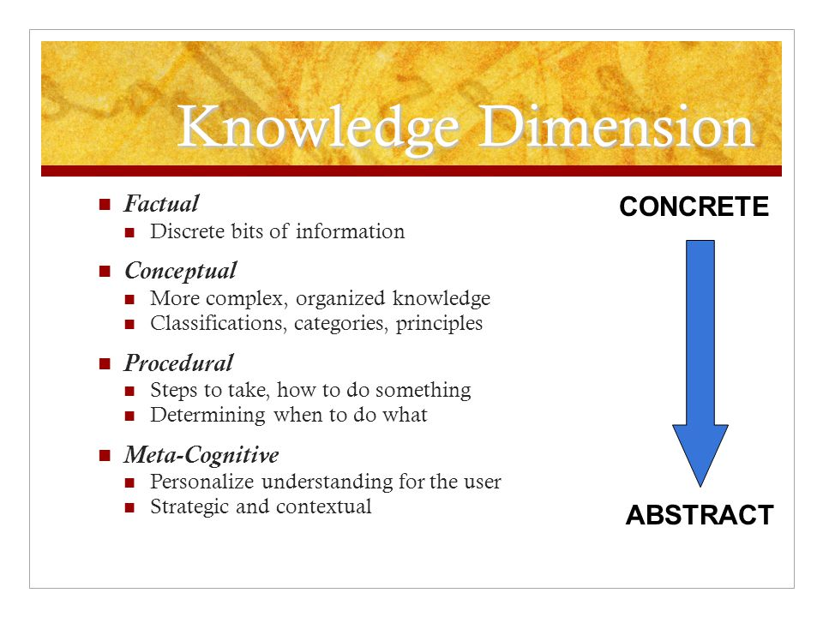

LEVELS
OF
KNOWLEDGE

Slide 22
Holistic Education
1. Cognitive: OBE using Bloom’s Taxonomy framework involving both lower order thinking & higher order thinking through
1. POs & PSOs
2. COs Agriculture_Psychomotor skills document.docx
&
Cognitive Skill (Head/ Mind)
Affective Skill (Heart /Soul)
Psychomotor Skill (Hand /Body)
Cognitive (Lower order Thinking )
Psychomotor
Affective
0
15
20
30
40
50
60
70
80
90
100
Low
High
Time ,Effort & Money

Slide 23
Holistic Education Delivery.
ACTIVITIES
Curricular
Extra-Curricular
Extramural
Co-Curricular

Slide 24
c. ACADEMIC APPROACH
Holistic Education Design & Multi disciplinary approach
CBCS & Out Come Based Education (OBE)
Bloom’s Taxonomy Framework
Alignment of Pedagogy with Outcomes ( Learning Experience)
Continuous Evaluation and alignment with Outcomes & Pedagogy
Programme Study & Evaluation Scheme of the concerned programme prepared according to the norms and standards as specified by UGC/concerned regulatory council, and National Education Policy-2020.(NEP-2020)
Skill Enhancement, Bridge & Value Added Courses

Slide 25
Student handout is fundamental to the “learning plan’’ and covers the following details:
Course Perspective
Programme Specific Outcomes (PSOs)
Course Outcomes (COs)
Contents Course handout SM_1 (2).docx
Assessment Strategy
CO- PSO Matrix
Learning Plan
Reference
Guidelines for project

Slide 26
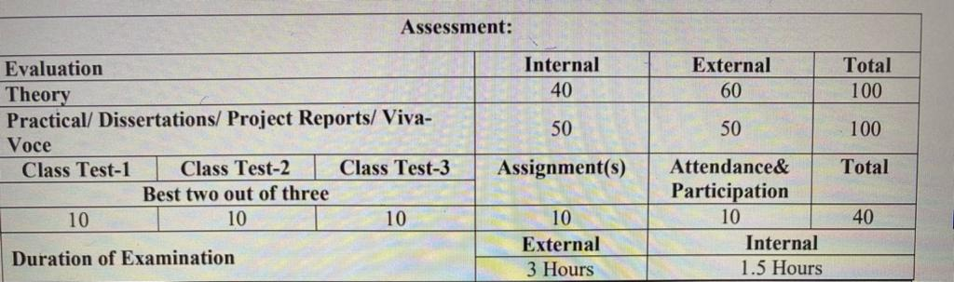
d. EXAMINATION PROCESS
CBCS & Credit based semester as well as annual system.
Internal and external assessment components for continuous and comprehensive evaluation of students’ performance.
Question papers are set & evaluated by the external examiners.
The Average time from the date of examination conducted and the date of result declaration is 15 days (Final year) and up to 30 days (for all other years).
While the internal evaluation comprises of two parts: 3 Tests, project / assignments, and attendance, the end semester examination is fully external for ensuring fair assessment of the students competence.
Note: the norms of concerned statutory council (wherever the council has prescribed so) are followed.

Slide 27
e. Student Details, Support & Progression
1) Total number of students enrolled currently: 10,246
Total no of students admitted in 2018-19: 3394
Total no of students admitted in 2019-20: 3364
Total no of students admitted in 2020-21: 2638
Total no. of students Admitted in 2021-22: 3916

Slide 28
STUDENT- CENTRIC – LEARNING ACTIVITIES
OBE
Preparation for Competitive Exam
Extra Mural Activities
Co-Curricular
Extra Curricular Activities
Counseling
Innovation Eco System
Student Centric living-learning
Activities
Industry & Educational visit
Training, Internship & Placements
Remedial Classes
Mentoring (Mentor Mentee system )
Bridge Courses
Skill Development
Field Project
Social connect

Slide 29
Cont …..
Book Bank
Hostels
Training & Placement
Scholarships
Gymnasium
Indoor And Outdoor Sports Facilities
Fee Concessions
Students Support & Facilities
Shopping Complex
Excursions
Medical Facility
Canteen & Restaurant
Bank & ATM
Transportation
Wi Fi Connectivity To Students’ Hostels
Communication Lab

Slide 30
Cont …
Information regarding Admission, Examination, Fees structure, syllabus and in other curricular and extra-curricular programmes are given to students through:
  Students creativity is reinforced through:
College Magazines
Wall Magazines
Competitions & creative activities sponsored by the University or other agencies
Guest lectures
Regular Educational and study visits
Prospectus published annually
Academic Calendar
Website
ERP
Circulars

Slide 31
f. RESEARCH, INNOVATION AND DEVELOPMENT ACTIVITIES
RESEARCH
A DEDICATED PH.D CELL
  University Research Consultation Committee(URCC) to encourage, facilitate and monitor various research activities Training Sessions on Research Methodology, Statistical packages for research etc.
  Licenses of Turnitin and Urkund (plagiarism check software's) to maintain high level of academic standards and integrity.
  Regular workshops conducted to sensitize the impact and effect of plagiarism.
SEED MONEY FOR MINOR RESEARCH PROJECTS
  Provision of seed money up to Rs. 2.00 lakh for minor research projects.
  15 Projects awarded worth Rs. 28 Lakhs.
RESEARCH FELLOWSHIP
Rs 20,000 is offered to candidates for full time Ph.D programme along with teaching assistantships to meritorious candidates.
Faculty members have submitted projects to funding agencies like DST, ICMR etc.
IPR CELL
The University has its to create an awareness about the importance and impact of filing patents, and other intellectual property rights, publication in Scopus, WoS, SCI indexed journal and facilitation for the same.
STUDY LEAVE: For pursuing higher studies like Ph. D and Post Doc from premiere institutions .
ACADEMIC LEAVE: 15 Days for participation in conferences, seminars, Workshops and giving lectures outside the University.

Slide 32


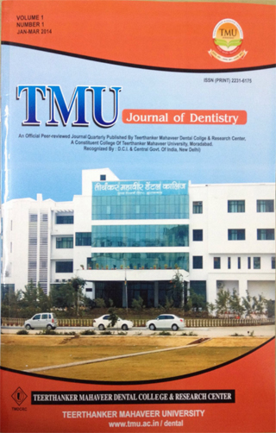
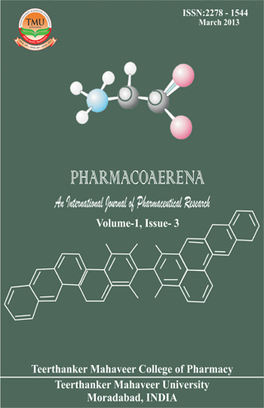
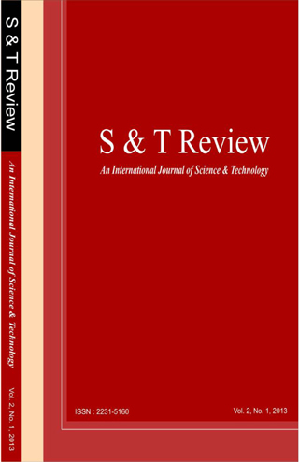
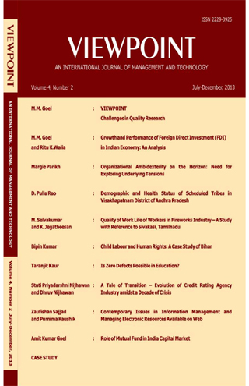
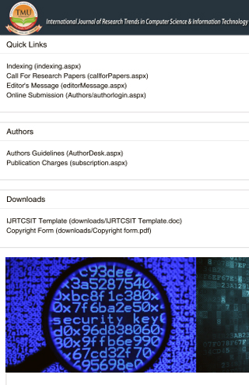

Cont ….
Research Resources
Plagiarism check through TURNITIN & URKUND
The University publishes the following journals on periodic basis:

Slide 33

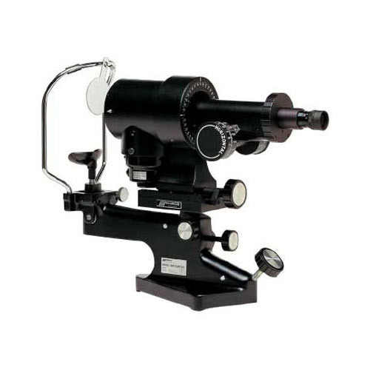
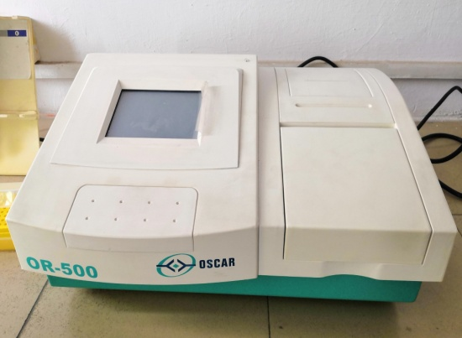
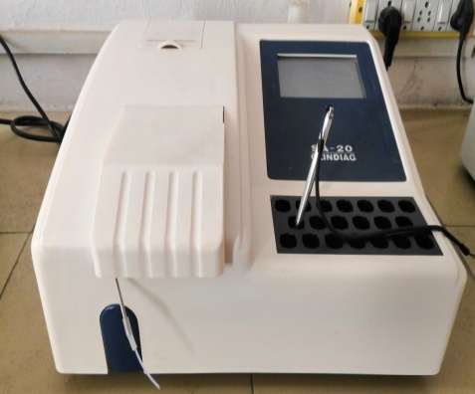
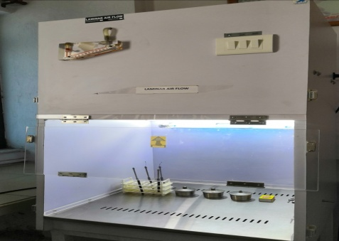
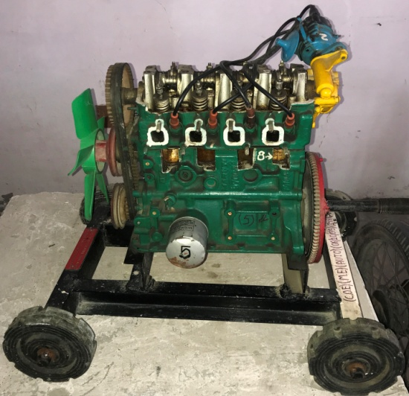
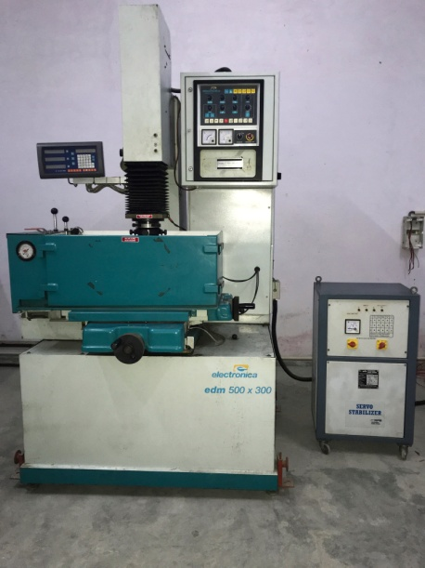
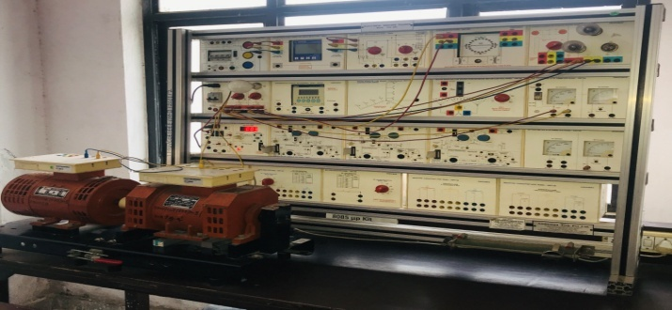
Major Equipments available for R&D
ELISA READER
Semi-Auto analyzer
Laminar Hood
KERATOMETER
Four stroke petrol engine
Electric Discharge Machine
Trainer kit

Slide 34
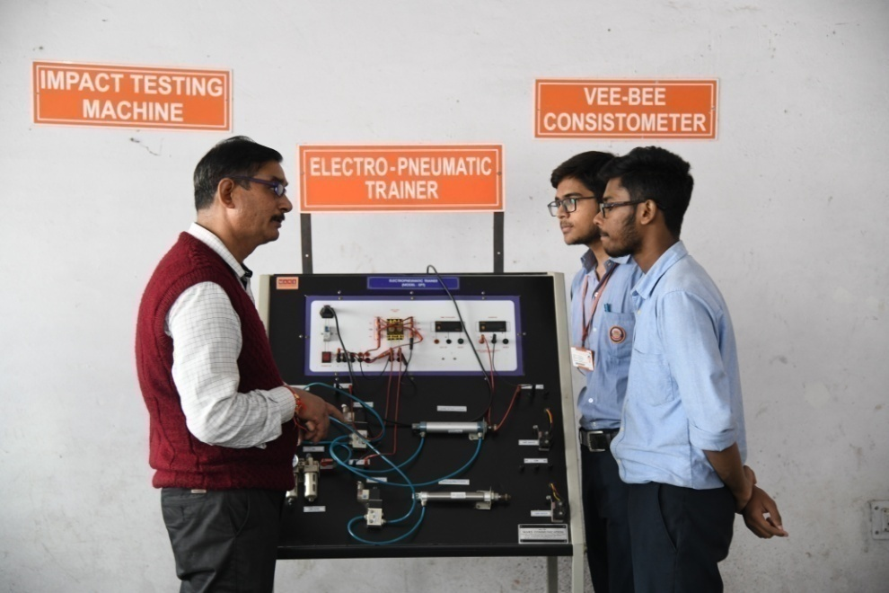
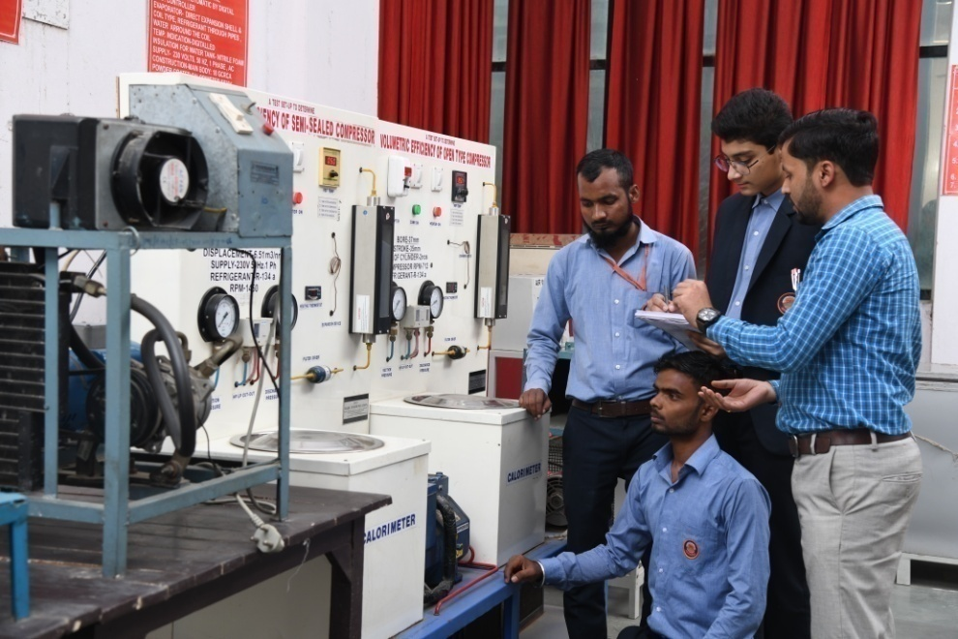
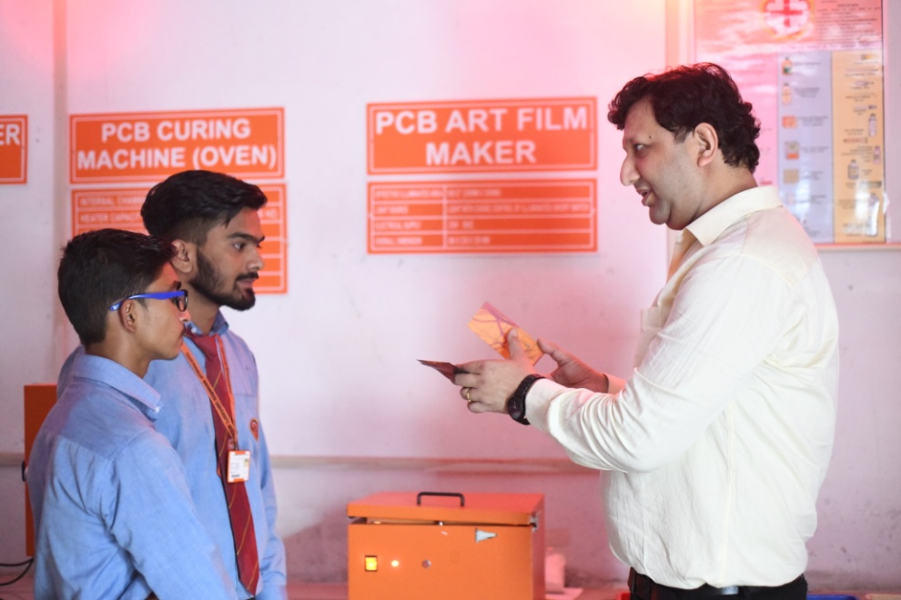
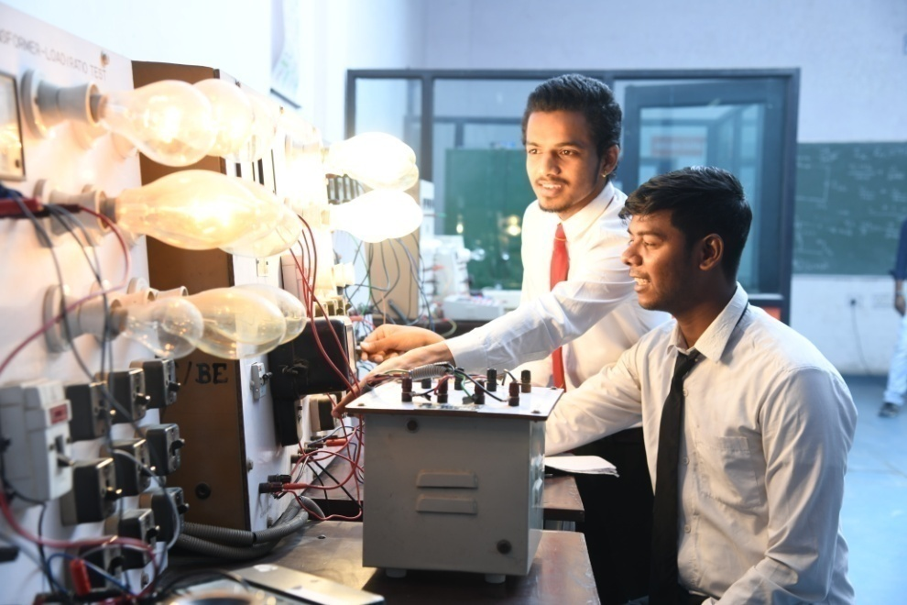
Research Facilities in well equipped Labs
Electronics and Electrical Engineering Labs

Slide 35
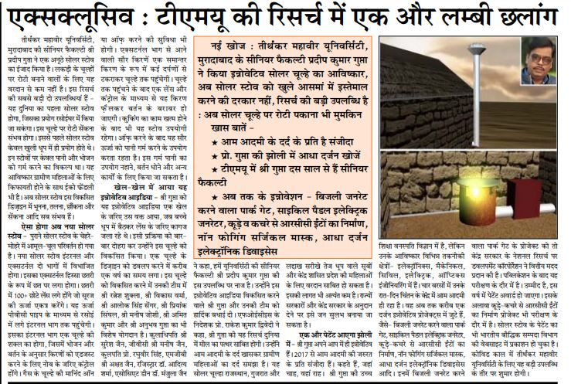
S. No. | Description | Total
A. | Patents | 2020-21
 | (i) Filed | 299
 | (ii) Published | 187
 | (iii) Awarded | 44
B. | Research publications in Indexed journals University H-Index | 1449 18
C. | Research project Grants
 | i) In progress | 09
 | ii) Completed | 15
D. | Consultancy Earning for 2020-21 | Rs. 58 Lakhs

Slide 36
S. No. | Description | Nos.
d. | Conferences/ Seminars/ Workshops | 231
e. | MoUs with Industry/ Institutes/ Universities
 | i) Signed | 52
 | ii) Operational | 52

Slide 37
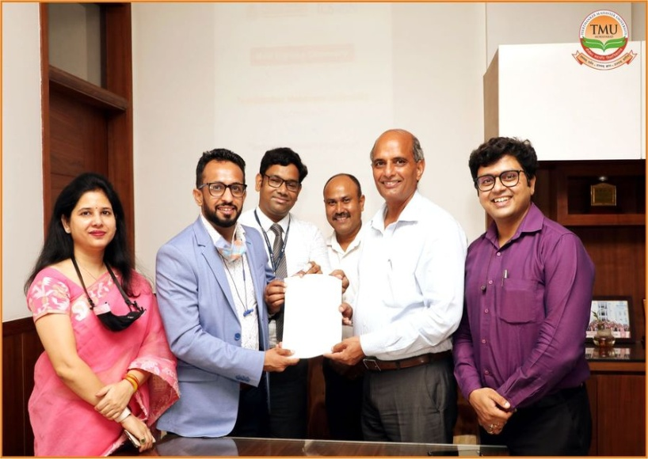
i. MoU’s, Partnership & Collaborations: 52
1. MoUs for Industry oriented collaborative Programmes (10)
Board of Apprenticeship Training, Kanpur
Imperial Society of Innovative Engineers (ISIE)
Bombay Stock Exchange
Cadd Center, Moradabad
IBM India Private Limited
DMR-HR Solutions
EDU BRAIN OVERSEAS PROJECT MGMT. SERVICES
i-Nurture Education Solutions Pvt. Ltd
Export Promotion Council for Handicrafts (EPCH)
TCS-ION
UR Services

Slide 38
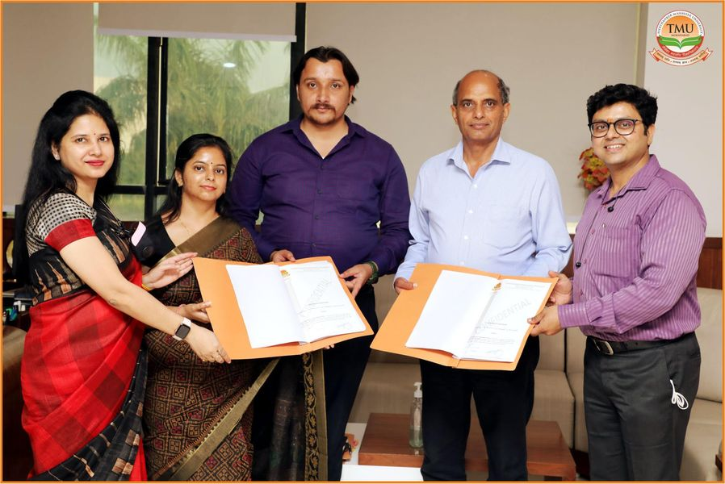
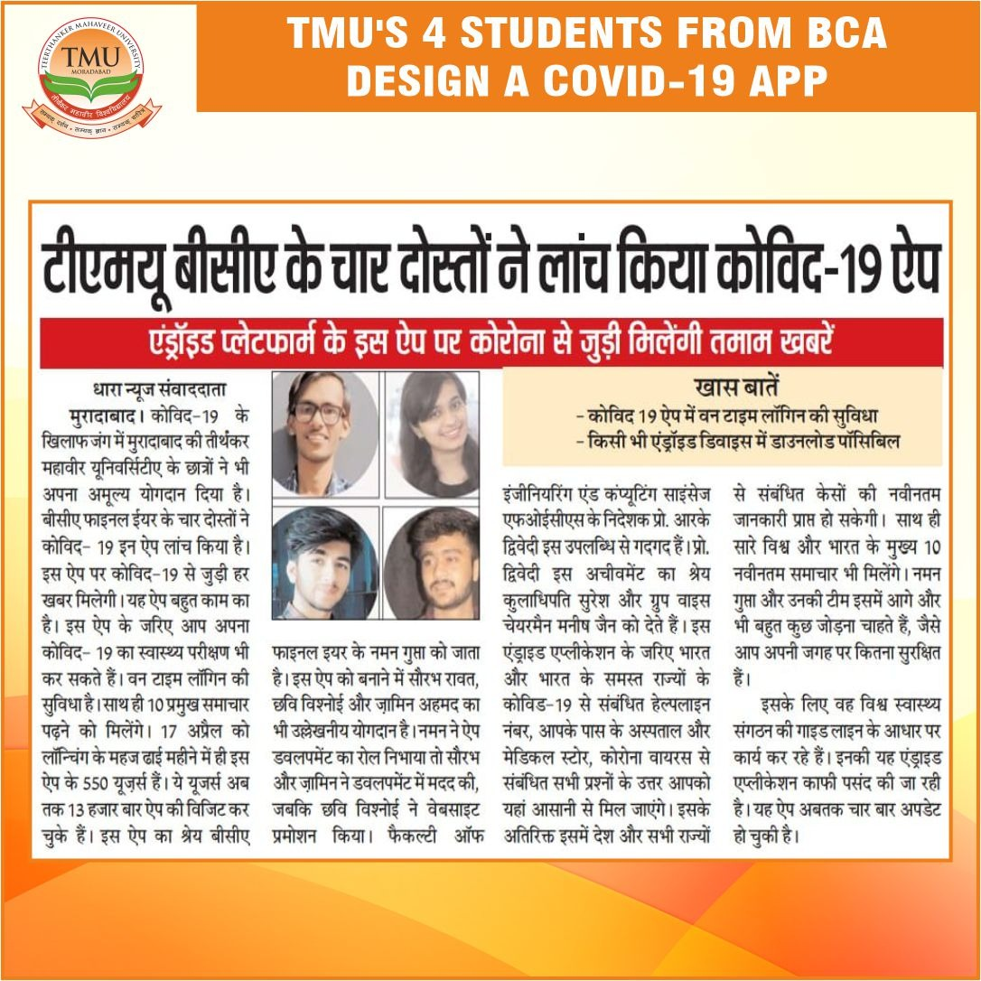
2. Skill Development, Innovation & Incubation Activities (18 )
AIC – BAMU
Atal Incubation Centre “BIMTECH” Greater Noida
IL & FS Skills Dev Corporation Ltd
IIT-Bombay for Spoken Tutorials
National Productivity Council (NPC), Min. of Commerce & Industries, Govt. of India
NVIDIA Corporation
University Technology PETRONAS (UTP) Malaysia(MoAC)
Youth Integrated Development Society (YIDS)
INNOSERV GROUP OF COMPANIES
BOSCH INDIA LTD
Aspiring Minds Assessment Pvt. Ltd Guraon, Haryana
Amperes Energy Solutions (AES)
Google Asia Pacific Pvt. Ltd
Health Care at Home India Pvt. Ltd (HCAH)
Jupitar Life Line Hospital, Mumbai
KRACKiN a Unit of iNURTURE Education Solutions Pvt Ltd
Sumandeep Vidyapeeth Deemed to be University
Voltrans Engrgy Pvt. Ltd

Slide 39
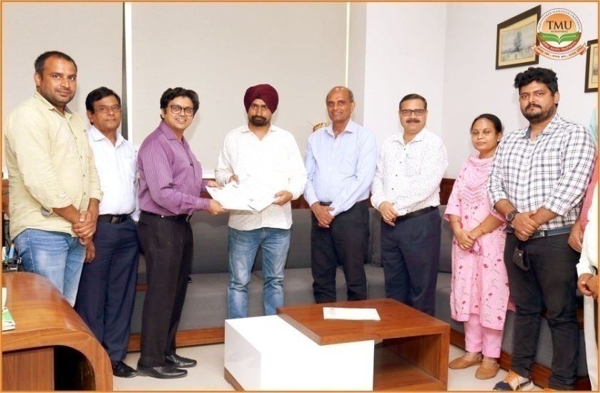
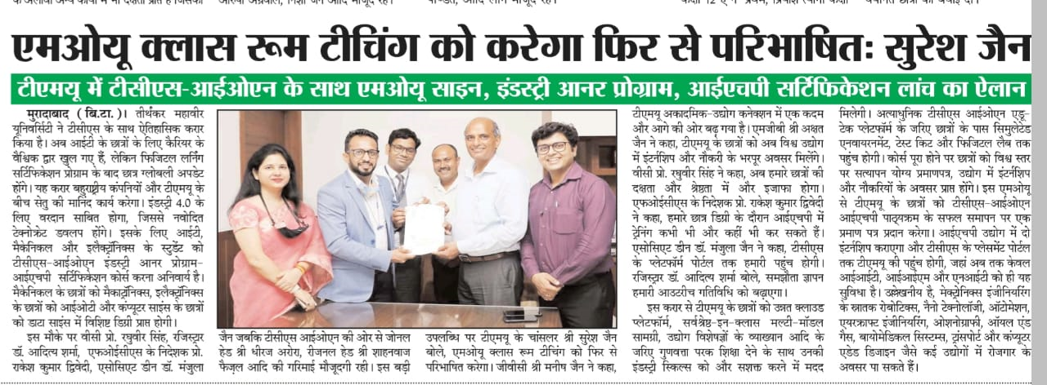
3. Research & Extension Activities (09)
Abhinav Prodhyogiki Udhyamee Vikas Simiti, MBD
Digamber Jain Trilok Shobh Sansthan, Jambu Dweep, Hastinapur UP 250404
Amperes Energy Solutions (AES)
Fatten Molecules Pvt. Ltd. for Agriculture
KLE College of Pharmacy, Belagavi
Smur Agro Ventures Pvt. (ASV Pvt.) For Agriculture
Sumandeep Vidyapeeth Deemed to be University (Dental)
University Technology PETRONAS (UTP) Malaysia(MoAC)
WWF (Consultancy Project)
Wyn Technology Pvt. Ltd. Delhi

Slide 40
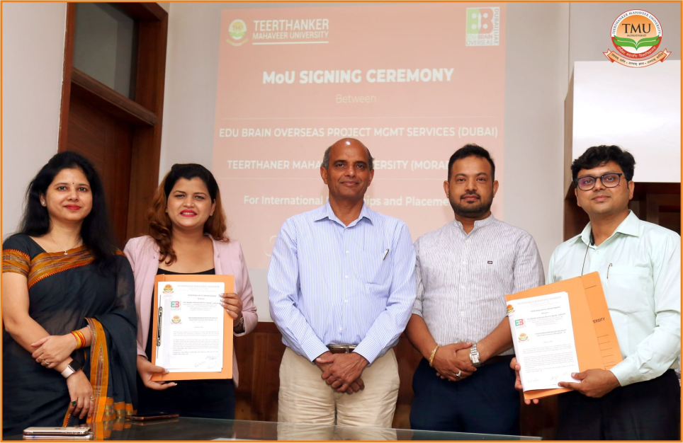
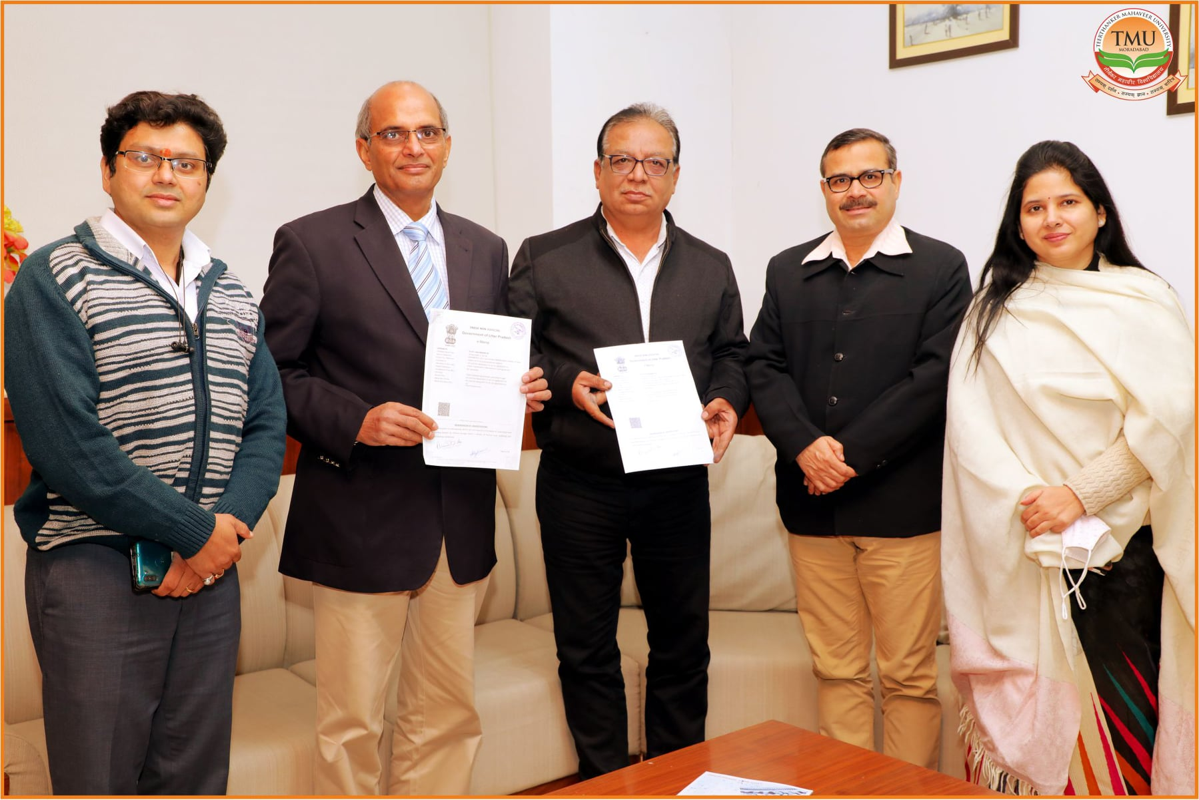
4. Internships, Training & Placement (11)
DMR-HR Solutions
EDU BRAIN OVERSEAS PROJECT MGMT. SERVICES
Global Health Pvt.Ltd. New Delhi / Medanta Sector 38, Gurgaon, Haryana
Health Care at Home India Pvt. Ltd (HCAH)
Jeevan Jyoti Hospital Moradabad
Jubilant Agriculture Rural Development Society(JARDS) Moradabad
Jupitar Life Line Hospital, Mumbai
Kaizen –HR Consultants, Rewari, Haryana
Smur Agro Ventures Pvt. (ASV Pvt.) For Agriculture
Sumandeep Vidyapeeth Deemed to be University (Dental)
VRRSP Technologies Pvt Ltd.

Slide 41
1. INNOVATION ACTIVITIES
TMU- Institution’s Innovation Council (TMU –IIC (IC201811637) established under the aegis of Innovation Cell of Ministry of Education (formerly MHRD), Govt. of India to foster the culture and develop ecosystem of innovation, entrepreneurship and start-ups in the University.
Besides, the IIC is also established at the level of the constituent colleges of the University viz.
Teerthanker Mahaveer Medical College & Research Centre : IC201811725
College of Agriculture Sciences : IC201811653
College of Computing Sciences & IT : IC201811732
Faculty of Engineering - : IC201811293
College of Nursing : IC201811733
College of Pharmacy : IC201811581
The activities are uploaded on the web portal of Ministry of Education on regular basis in every quarter.
College of Computing Sciences & IT has secured 4-star rating by Institution Innovation Cell, Ministry of Education, Govt. of India
Faculty of Engineering has secured 3.5-star rating by Institution Innovation Cell, Ministry of Education, Govt. of India

Slide 42
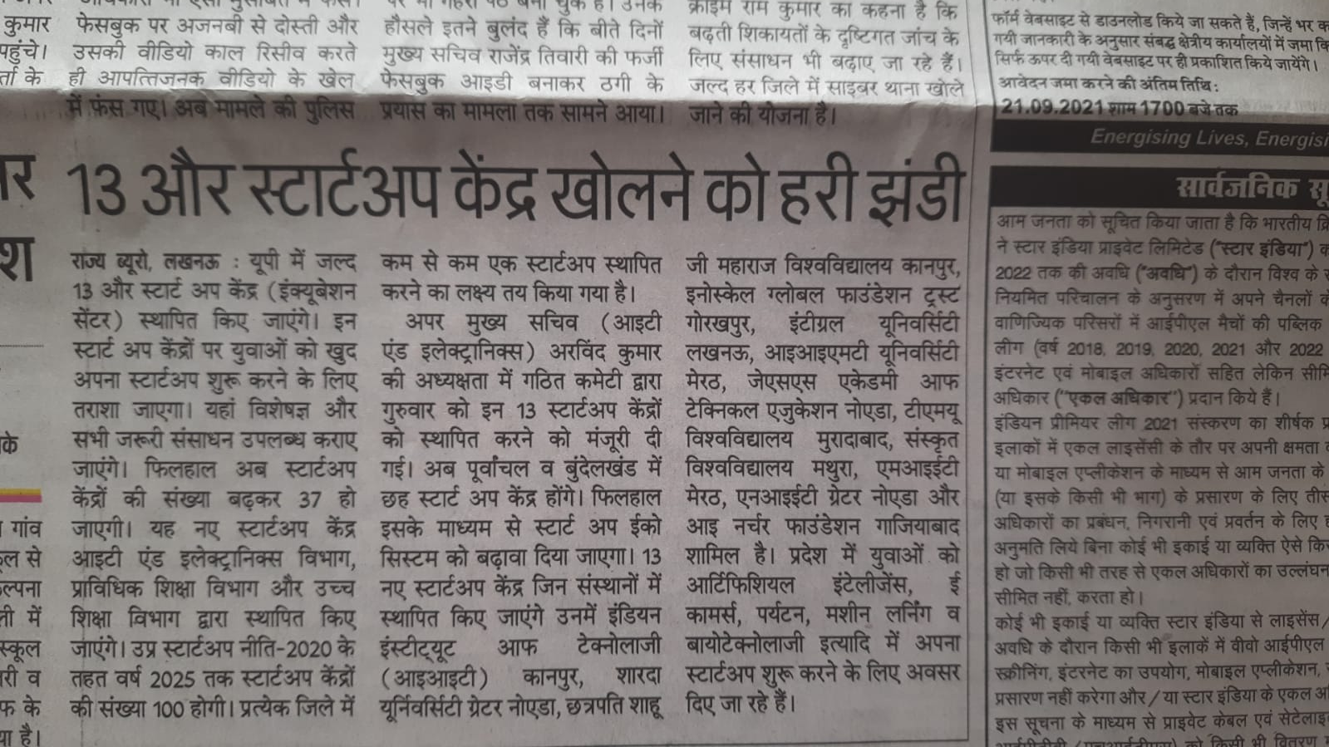
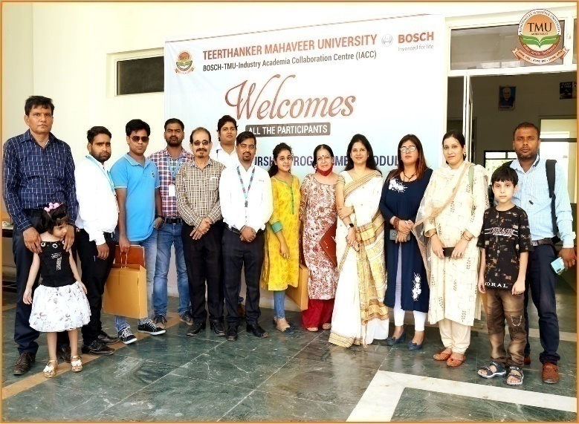
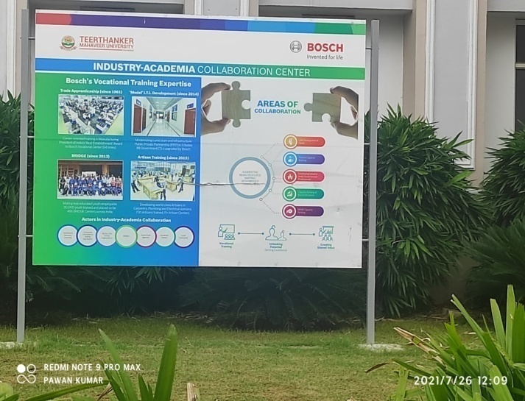
TMU- Business Incubator Centre (TMU-BIC ) is
also registered with START-UP India and is
Approved by U.P. Government under U.P. START-UP-2020 scheme .
The University is amongst select private universities (approx. 23) in India which has been selected for the BOSCH Industry-Academic Collaboration. Bosch has established its Industry-Academia Collaboration Centre (IACC) for working together on skill development areas in the following :
Skill Development of youth
Trainer’s Capacity Building
Industry ready Social Service Professional
NGO Capacity Building
MSME Capacity Building
ENTREPRENEURSHIP DEVELOPMENT CELL (EDC)

Slide 43

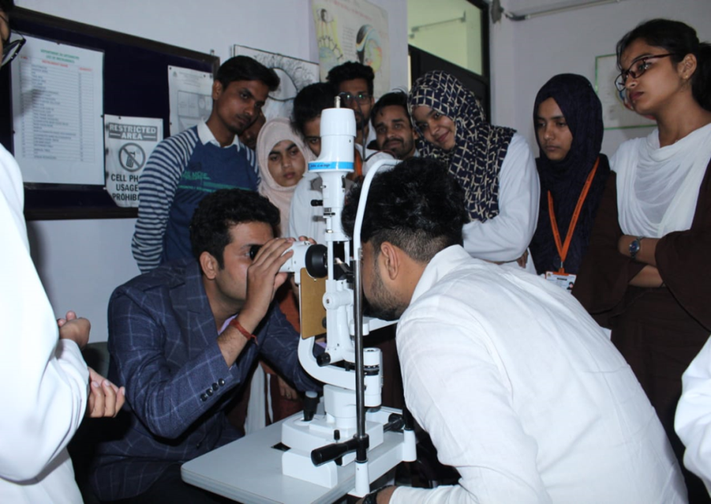
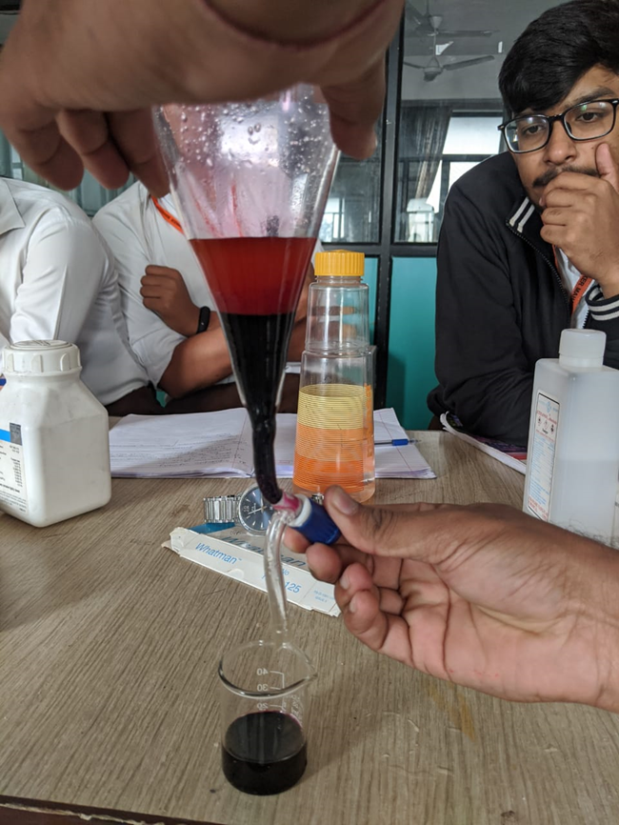
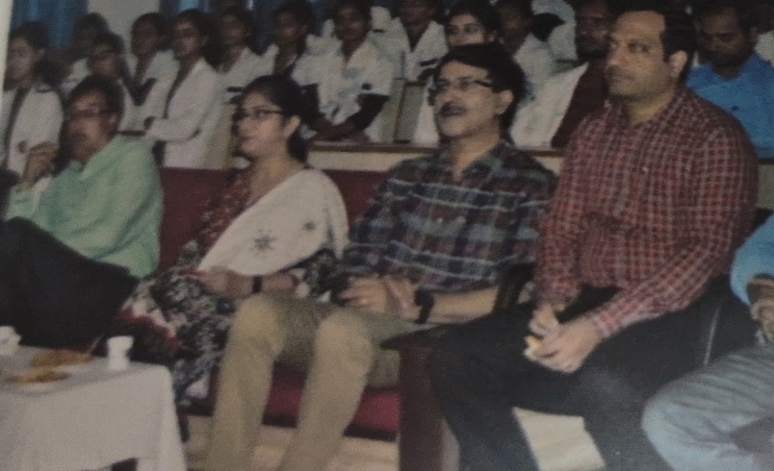
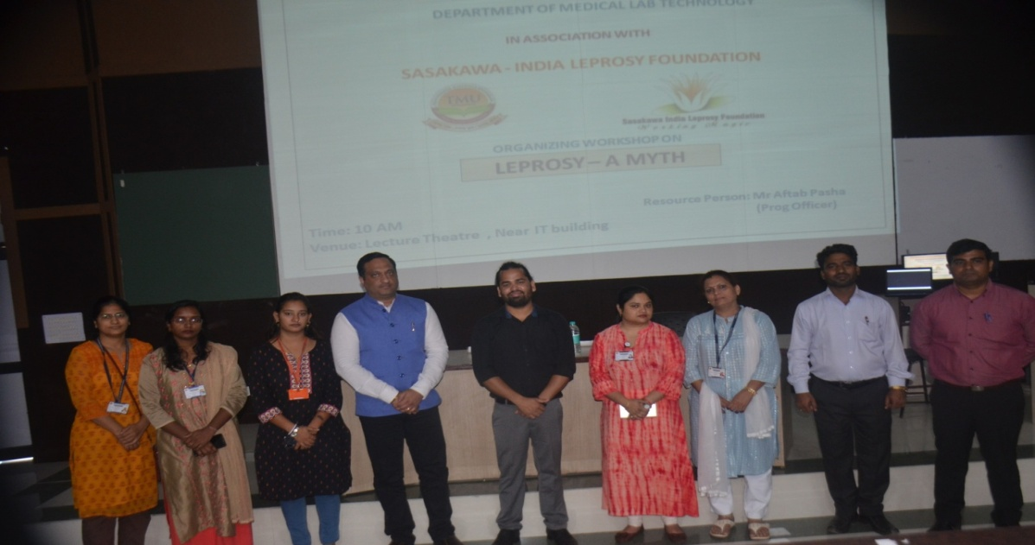
Guest lectures/Workshops/Conferences
Guest Lecture on Applications of NAT in blood transfusion
Workshop on Leprosy

Slide 44
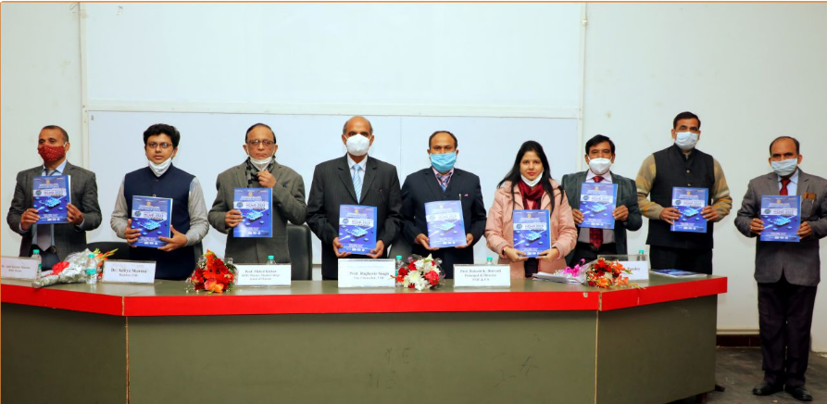
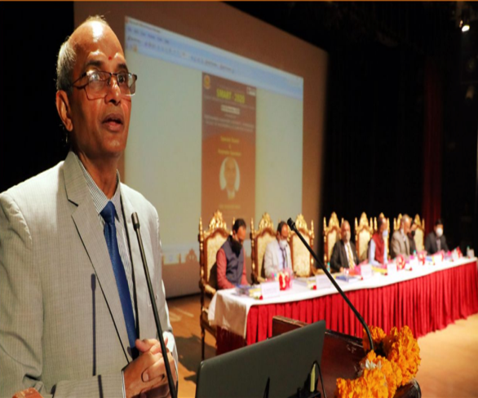
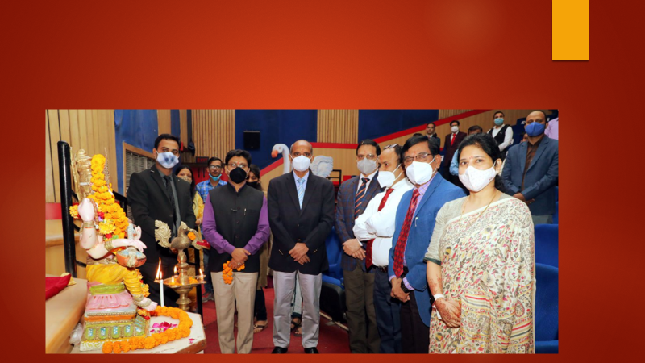
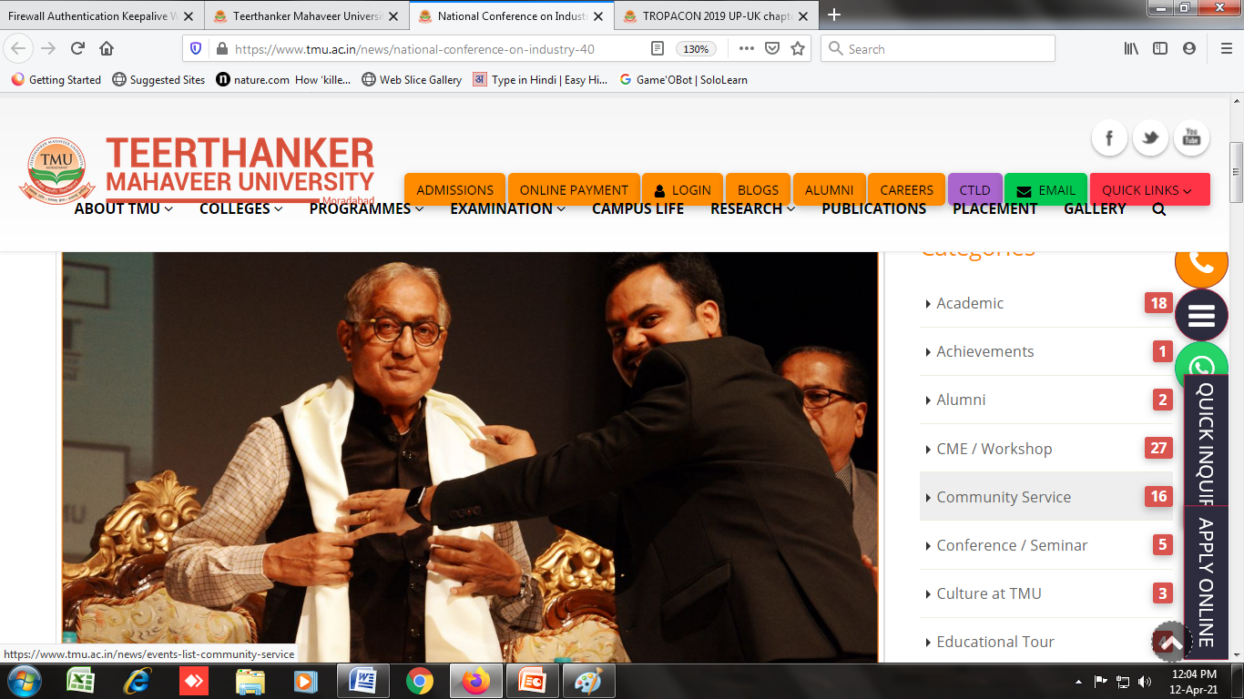
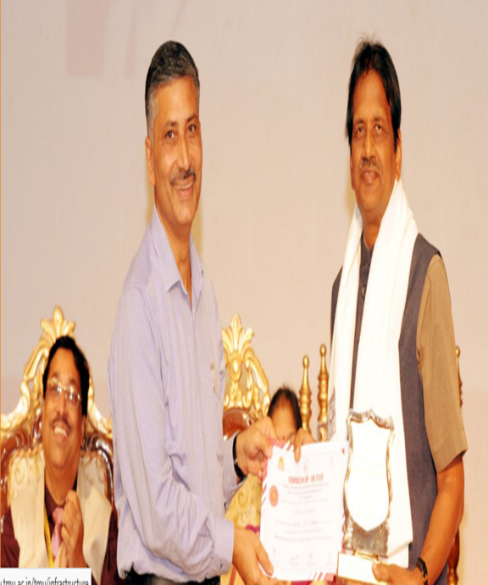
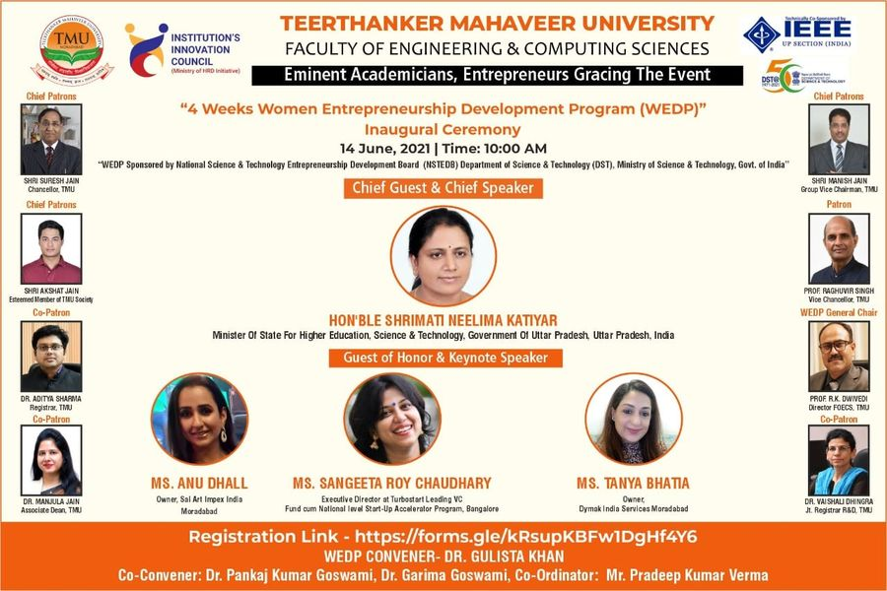
National Conference on Materials and Devices -2020 at TMU
5th International Conference on Advancement Computing (ICAC-2020) (07 Nov)
National Conference on Industry 4.0
TROPACON 2019 UP-UK chapter conference

Slide 45
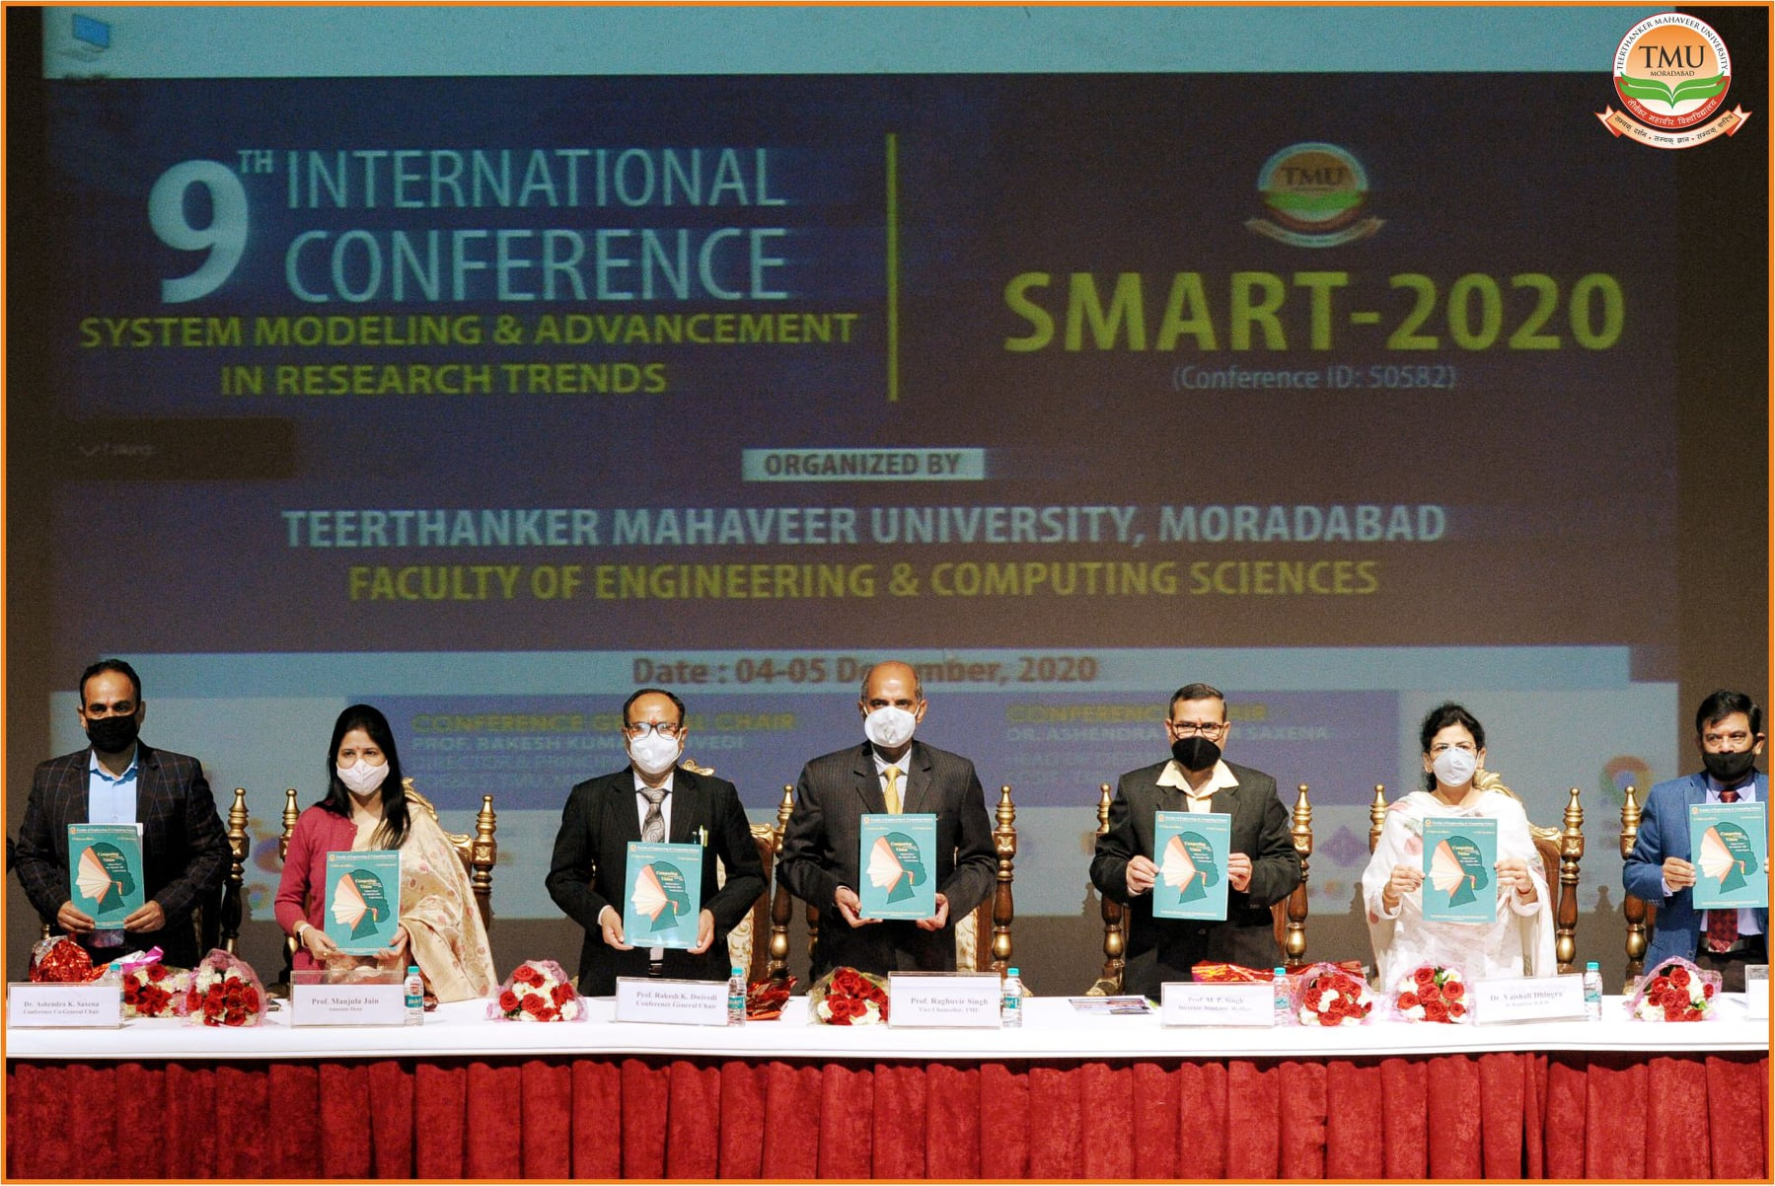
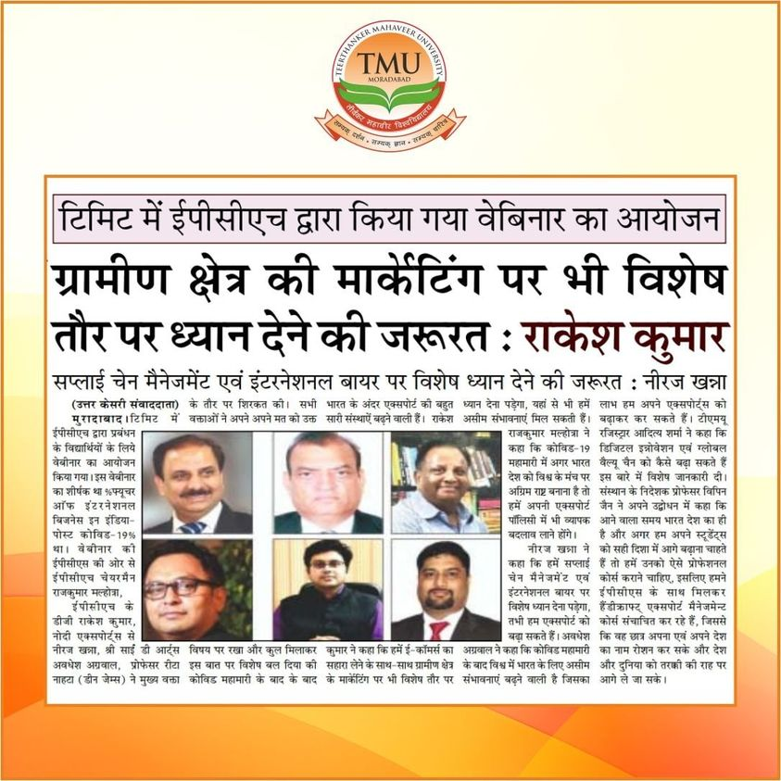
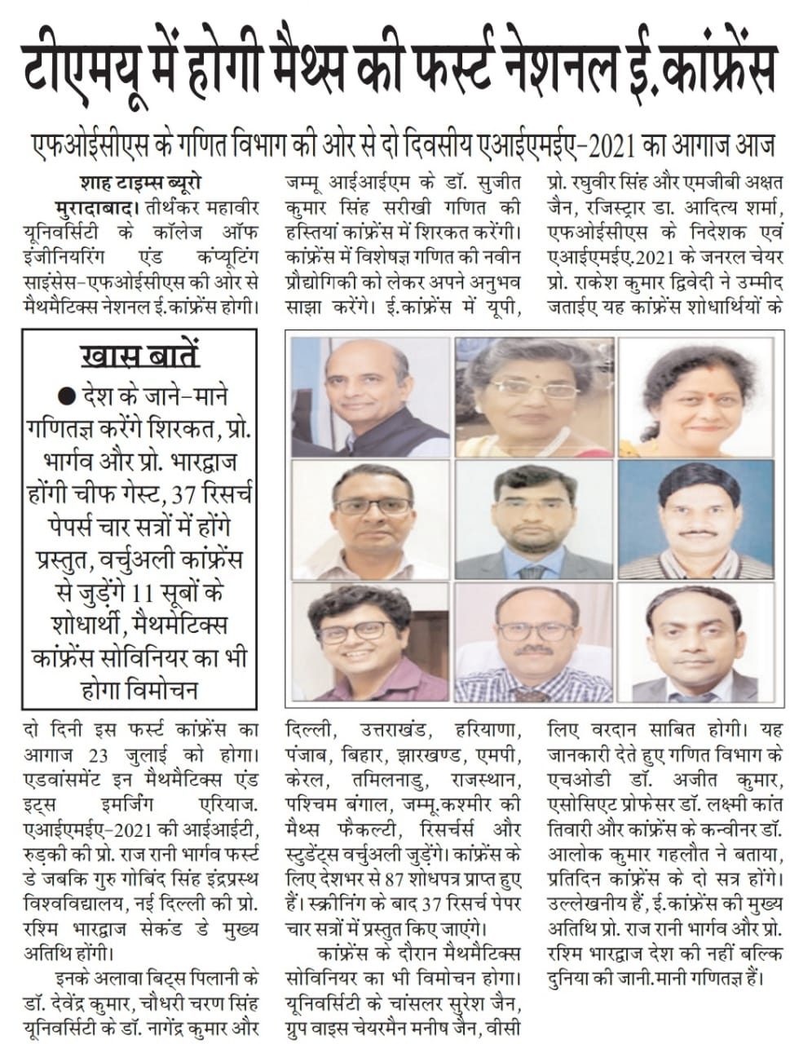
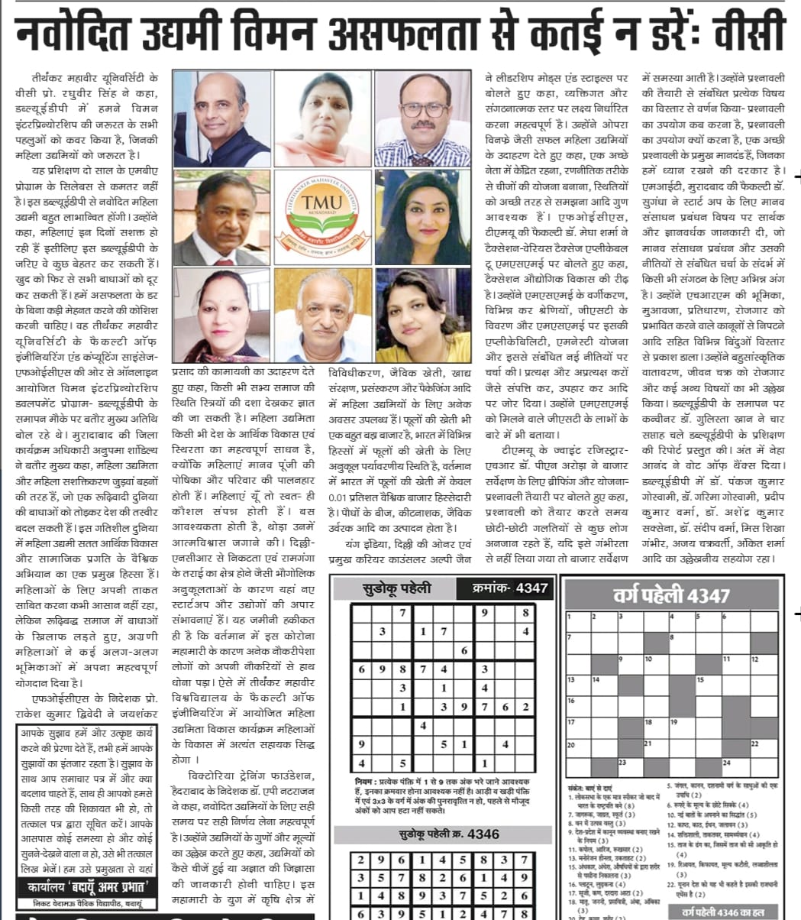

Slide 46
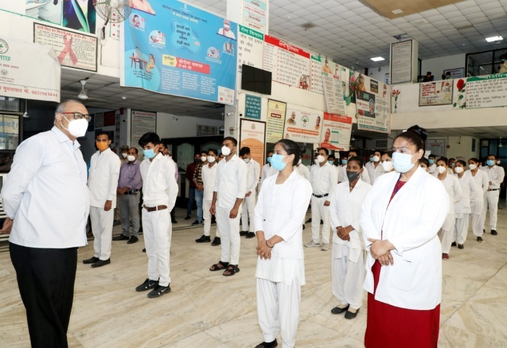
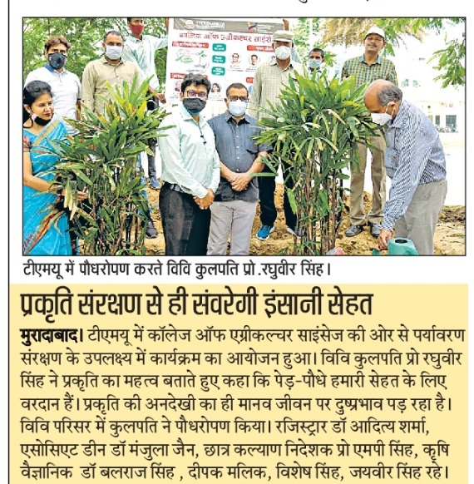
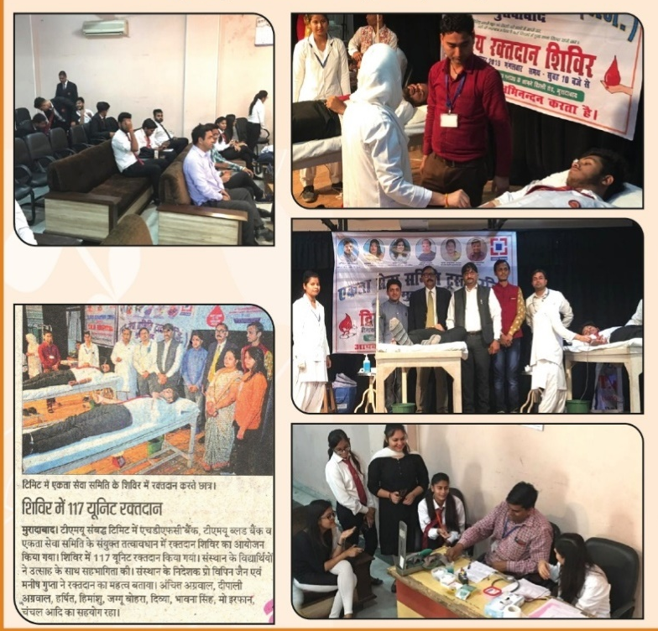
g. EXTENSION & OUTREACH ACTIVITIES
The University has a well constituted committee under the chairmanship of DSW to conduct extension activities namely:
Adopted 5 villages, to contribute to the betterment of health & sanitation, education, agricultural and social welfare programmes under UNNAT BHARAT ABHIYAN
Student sensitization programmes on social issues
Outreach programmes conducted through NSS or independently/in collaboration with NGO namely:
Scout & Guide programme
Swacch bharat,
AIDS awareness,
Gender Issues
Awareness Programme On Personal Hygiene

Slide 47







Zero Wastage Initiative
Teaching To The Children Of Non-teaching Staff
Voters Awareness Programme
Blood Donation Awareness
Financial Literacy Programmes
Road Safety Programmes

Slide 48




Events conducted to commemorate renowned personalities, national days, values & ethics, Non-violence, etc.

Slide 49


h. SPORTS, CONVOCATION & CULTURAL ACTIVITIES
Combination of outdoor and indoor opportunities.
Multi-purpose indoor sports complex for table-tennis, basketball, volleyball, badminton, gymnastics, yoga, squash, tennis, and skating & has housed many state and National level tournaments.
State-of- the-art gymnasium having sophisticated equipment.
Cricket stadium and pavilion par excellence. Twenty turf wickets of the University comply with the international standards and have hosted prestigious tournaments like RANJI TROPHY and COOCH BEHAR TOURNAMENT.

Slide 50
Biggest Indoor Stadium of Uttar Pradesh. The prominent tournaments and Championships organized:
13th Youth National Volleyball Championship in 2011
62nd Senior National Volleyball Championship in 2013
11th Inter Zonal National Carom Championship in 2014
42nd Junior National and Inter State Carom Championship in 2014
44th Senior National and Inter State Carom Championship in 2014
U.P. Gramin Volleyball League in 2016
TMU Open Basketball Championship in 2016
East Zone Inter State Senior and Junior Under 19 Selection
Badminton Tournament in 2017
U.P. Senior State Basketball Championship (Men and Women) in 2019
Inter Region Football Championship leading to selections in the prestigious Santosh Trophy.

Slide 51
An international standard cricket stadium with a dedicated clock tower pavilion. Major tournaments hosted by the University’s cricket stadium are as follows:
Cooch Behar Cricket Trophy in 2013
Col. C.K. Nayudu Trophy in 2013 and 2014
Ranji Trophy in 2014
1st UP Junior Tennis Cricket Championship in 2016
2nd Tennis Cricket Federation Cup in 2018

Slide 52





5th CONVOCATION 2021 (31.07.2021)
Graced by Chief Guest Hon'ble Deputy Chief Minister of Uttar Pradesh Dr. Dinesh Sharma and Guest of Honour Hon'ble Cabinet Minister Panchayati Raj ( U.P) Shri Bhupendra Singh Chaudhary

Slide 53


C. INFRASTRUCTURAL AND OTHER FACILITIES
Administrative Block
Academic Blocks
Central Library
Sports & Recreational Facilities
Medical Facilities
Others:
a) Auditorium
b) Amphitheatre
c) Shopping Complex
d) Bank & ATM
e) Guest House
f) Hostel Facility
g) Residential Facilities for Faculty & Staff
h) Riddhi Siddhi Bhawan for Religious Activities
i) Jinalaya
j) Sewage Treatment Plant
k) Mortuary
l) Transportation Facility

Slide 54


1. ADMINISTRATIVE BLOCK (Pic of Admin Block , committee roo)
a. Chambers / Offices :
Chancellor
Group Vice Chairman.
Members of Governing Board.
Vice Chancellor.
Registrar.
Dean-Academics.
Associate Dean
Joint Registrar –HR
Joint Registrar - Academics
Joint Registrar- R&D
b. Admission Office
c. ERP Cell
d. Digital marketing Cell
e. Registration & Migration
f. Committee Room
g. Pantry
h. Restrooms (Males & females)

Slide 55



2) ACADEMIC BLOCK
Classrooms/ Classrooms with ICT : 231/221
Classrooms with Smart boards : 12
Seminar Halls : 12
Conference Rooms : 07
Laboratories : 164
Besides, all academic blocks have:
Directors/ Principal Chambers
Faculty Rooms
Departmental library
Pantry
Common room for boys
Common room for girls
Restrooms-males & females
IT Infrastructure:
Computer Lab with Internet and Wi-Fi Facility
Computer/Laptop with Internet Facility in respective Faculty Chambers
LAN & Wi-Fi Facilities, Software – All Latest Versions, UPS, Printers, Scanner Photocopier, LCD Projectors

Slide 56


3) CENTRAL LIBRARY: A LEARNING RESOURCE
Salient Features:
Four major branches situated in different Academic Blocks.
Fully automated with KOHA Software for library management
Books issued through bar-coded membership cards
Catalogue of the Central Library available on internet/intranet for search.
CCTV cameras installed to ensure safety of the Library materials.
OPAC (On-Line Public Access Catalogue)
Remote Access for E-books & E-Journals (Map My Access)
Books available: 2,43,943
Titles: 57,113
Journals : 343 (National: 175, International:168)
E Books–38,808: Business subscription collection, E- book Engineering Core
Subscription; e- book IT Core, Clinical subscription; Nursing; Delnet
E –database: Ebsco host (business Host), Lexis-Nexis, Delnet, Medline Complete,
Dentistry, Academic Search Elite
E- journals: 9,163
News Papers /periodicals:10/ 20

Slide 57




5 ) MEDICAL FACILITIES: HUMANITY PAR EXCELLENCE DURING COVID-19 PANDEMIC
1008+ bedded multi-specialty hospital
Converted as the biggest L-3 category hospital for Covid-19 COVID-19 Hospital in April 2020 by the Government of Uttar Pradesh to treat coronavirus patients from five districts of Moradabad Division namely, Moradabad, Rampur, Bijnor, Amroha and Sambhal.
Accorded Level-3 status (i.e. for treating patients with maximum comorbidities)
Record of treating highest number of COVID-19 patients across the state of Uttar Pradesh (4500+) as compared to any other private hospital in the state of Uttar Pradesh.
Initiated BSL-2 Molecular Laboratory for the purpose of RT-PCR testing, a gold standard for all viral infection tests. It was inaugurated by the Chief Minister of Uttar Pradesh Shri Yogi Adityanath on 31 August 2020.
Houses various clinical and para-clinical departments.
High capacity oxygen generator unit manufactured & funded by the French company MIL’S, under an initiative led by the Government of France.
Produces medical oxygen from ambient air to supply a hospital’s oxygen network with a flow rate of up to 13,000 liters per hour (210 liters per minute).

Slide 58



OTHER FACILITIES @ UNIVERSITY
Centrally air-conditioned auditorium with 550 seats, equipped with modern acoustics and digital projection.
Shopping Complex having ATM, Costa Coffee, bookshop, pharmacy and bank, convenience store and a Students' Union Shop, offering a range of groceries, gifts, and supplies.
Punjab National Bank providing all banking facilities including lockers and ATM on campus.
A Well-furnished guest house for visiting faculty, academicians and other dignitaries connected to the University.
Hostel facilities (on single occupancy basis as well as on sharing basis):
Boys Hostel : 02 ( accommodating 2500 boys )
Girls Hostel : 03 (accommodating 2100 girls )
Residential Facilities for faculty & Staff:
Riddhi Siddhi Bhawan For Religious & cultural activities
Jinalaya for offering prayers
Sewage Treatment Plant
Mortuary
Transportation facilities including 61 Buses, 02 Tempo Travelers 09 Cars, 3 Ambulances including 2 Critical Care Ambulances, 4 Small Trucks for carriage and 2 Tractors with Trolleys, 01 JCB and 2 Tankers for agriculture and plantation purposes in the campus.

Slide 59
Library Membership
DELNET
INFLIBNET
Sodh Ganga
Sodh Sindhu
NDL
NPTEL
NMEICT
SWAYAM
ePGPathshala
UP Higher Education Digital Library

Slide 60
EDUCATIONAL AND COMMUNICATION TECHNOLOGIES
The University has the following array of digital tool & technologies to advance the students learning.
No. of computers in labs: | 1920
No. of license software: No. of Operating Systems | 1920
SPSS | 10
Adobe | 15
Simulation software | 03
Microsoft Dynamic NAV licenses | 56
Dental Management Software | 01
HIS-Miracle | 01
Campus Connect | 01

Slide 61
Contd…
I-Mac Operating System | 15
Coral Draw | 05
SQL server | 04
User CAL | 20
Device CAL | 22
Window Server Standard | 04
CRM (Lead Management system) | 35
Zoom license for online classes | 10
Microsoft Campus Agreement for all labs | 200
No. of simulation labs | 02
Olympus Great Learning LMS
Hospital Information System software | 01
Dental OPS using Dental Management software (DMS). | 01

Slide 62
Additional Facilities @ University :
Connectivity to National Knowledge Network under NME-ICT program of GOI
In-house ERP using Microsoft Dynamics NAV to handle different academic activities such as
Admissions.
Enrolment.
Fee Collection.
Academic Module.
Examinations.
Students’ Information.
Training & Placement.
Students’ Assessment.
TMU is the local chapter of NPTEL

Slide 63
Contd…
Internal Quality Assurance Cell (IQAC) for quality improvement & compliance on the observations made during the academic audit.
Centre for Teaching Learning & Development (CTLD) for soft and aptitude skills and pedagogical skills to the teachers and Intensive Teaching Workshops (ITW) for teachers.
Orientation/induction programme for the new teaching and non-teaching staff once every six months by HR department.
Member of various professional bodies like AIU, AIMA, CSI, FICCI, IEEE, IHC, IIC, IDA,ISTE, PHDCCI, IIRS-Dehradun.

Slide 64
D. AWARDS & ACHIEVEMENTS
‘Best Private University’ Award by the Journalist Federation of India.
Bhagwan Rishabhadeva International Award in 2018 , in recognition of Shri Suresh Jain’s selfless contributions.
Best Multi Speciality Hospital of the Year by Indo-Global Health care Summit & Expo, 2014.
For Innovations and Advances in medical care by Indus Foundation Jun, 2014.
Top Dental College of Northern India at fifth edition of the Indian Health Professionals Awards organized by Pune-based research organization "International Research Organization for Life and Health Sciences“ on 13th March 2021 at Mumbai.
“High Citation Achiever” 123th rank in Asia for Discipline of Oral Medicine And Radiology ranked by AD Scientist Index, Turkey.
Best business model development competition in Sixth Indo-German workshop on Sustainable Manufacturing and Entrepreneurship, 17-18 September 2018 at BITS, Pilani.
And many more………………

Slide 65
ACHIEVEMENTS
Smart India Hackathon-2020: FOE students won cash prize of Rs. 1lakh.
Novel privilege for TMU's FOE to be the Nodal Center for TOYCATHON-2021.
TMU Hospital achieved top position in UP for treating record number of patients under Pradhan Mantri Jan Arogya Yojana –AYUSHMAN -2021
Has contributed more than 500+ e-modules from varied streams to Uttar Pradesh Higher Education Digital Library
Medical faculty Dr. Prerna Gupta represented TMU & won crown of Mrs. India-2021 in the Month of August

Slide 66
E. BEST PRACTICES
Industry immersion programme
Holistic Education
Delivery Process : Skill Focus
Roadmaps & PMS as performance enablers Performance Management System for Faculty (1).xlsx
Faculty Development :
a. Domain (Knowledge + Skills) Format for Developing Roadmap.xlsx
b. Soft Skills (Attitude)
c. Research & Projects
d. Educational Domain
e. Technology (Simulation + Software)

Slide 67
F. Aspirational goals
Continuous quality improvement using “Deming Quality Cycle”
Research Out put & Impact: TOT, Prototypes, Top 5-10 Percentile citations
Immersion Technology for Skilling up (VR, AR, MR]
Experiential & Action learning
International Collaborations
a. Semester or year Internship for Students
b. Faculty exchange, Training & Research
Research Degree based on problem solving
Bespoke Degree programmes
Application of Immersion Technology in Learning
Focus on Incubation & Start-ups

Slide 68

Thank You!

